Slide 1
Bertrand's Postulate
Ben Folland

Slide 2
What is my EMC ?
Put it simply – Prime numbers.
I have looked at different theorems about the primes – and for some of them have delved deep into there proofs.

Slide 3
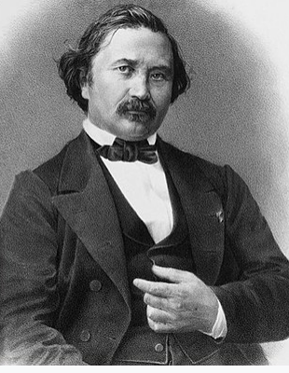

Who is Bertrand and why is there a postulate named after him?
$n<p<2n$ for $n>3$
19th century
French
Number theory, probability theory, economics, thermodynamics, differential geometry

Slide 4

How do we prove Bertrand?
The 4 lemmas
Bounding $\left(\begin{aligned}2n \\ n\end{aligned}\right)$
Contradiction

Slide 5
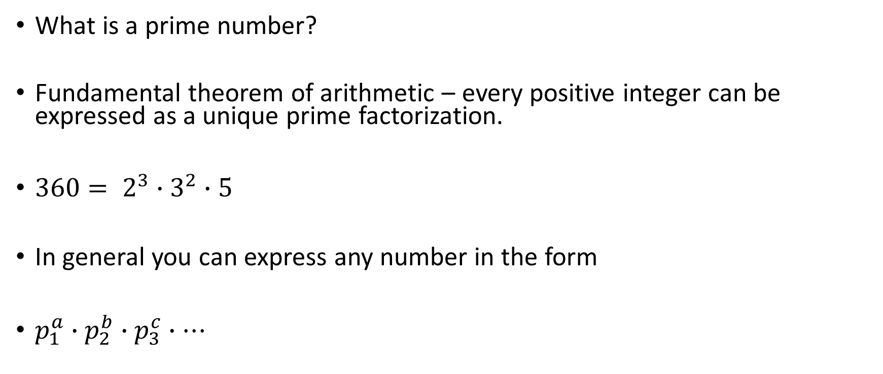
Prime factorisation
What is a prime number?
Fundamental theorem of arithmetic – every positive integer can be expressed as a unique prime factorization.
$360= 2^{3}∙3^{2}∙5$
In general you can express any number in the form
$p_{1}^{a}∙p_{2}^{b}∙p_{3}^{c}∙…$

Slide 6

Binomial coefficients
$\left(\begin{aligned}n \\ r\end{aligned}\right)=\frac{n!}{r!\left(n−r\right)!}$
$n!=n\left(n−1\right)…\left(1\right)$ so $5!=5\left(4\right)\left(3\right)\left(2\right)\left(1\right)=120$

Slide 7
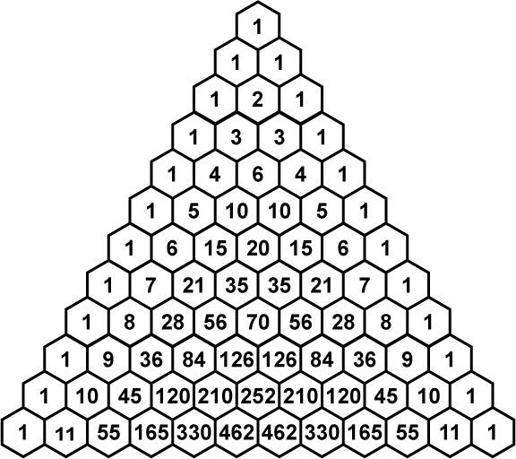





Quick note on $\left(\begin{aligned}2n \\ n\end{aligned}\right)$
‘Middle binomial coefficient’ $↔$ Largest binomial coefficient on its row
A whole entire book on$\left(\begin{aligned}2n \\ n\end{aligned}\right)$exists if you're interested.

Slide 8

Notation
$$\prod_{n=1}^{10}{p}=2∙3∙5∙7∙11∙13∙17∙23∙29∙31=big number$$
$a | b$means $b$ is divisible by $a$
For example $5 | 25$ but $6 | 25$

Slide 9

The 4 Lemmas; part 1 – The lower bound
Claim:$\frac{4^{n}}{2n}≤ \left(\begin{aligned}2n \\ n\end{aligned}\right)$
Consider ${4^{n}=(1+1)}^{2n}=\sum_{k=0}^{2n}{\left(\begin{aligned}2n \\ k\end{aligned}\right)}$
Well $\left(\begin{aligned}2n \\ n\end{aligned}\right)≥\left(\begin{aligned}2n \\ k\end{aligned}\right)$ therefore ${(1+1)}^{2n} ≤2n \left(\begin{aligned}2n \\ n\end{aligned}\right)$ so $\frac{4^{n}}{2n}=\left(\begin{aligned}2n \\ n\end{aligned}\right)$

Slide 10
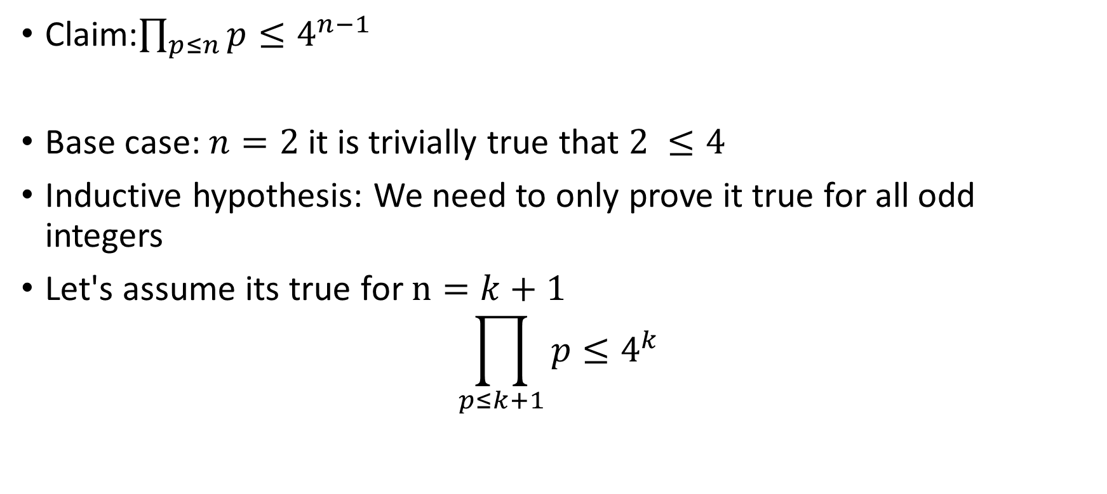
The 4 Lemmas; part 2 – a product of primes
Claim:$\prod_{p≤n}{p}≤4^{n−1}$
Base case: $n=2$ it is trivially true that $2 ≤4$
Inductive hypothesis: We need to only prove it true for all odd integers
Let's assume its true for $n=k+1$
$$\prod_{p≤k+1}{p}≤4^{k}$$

Slide 11
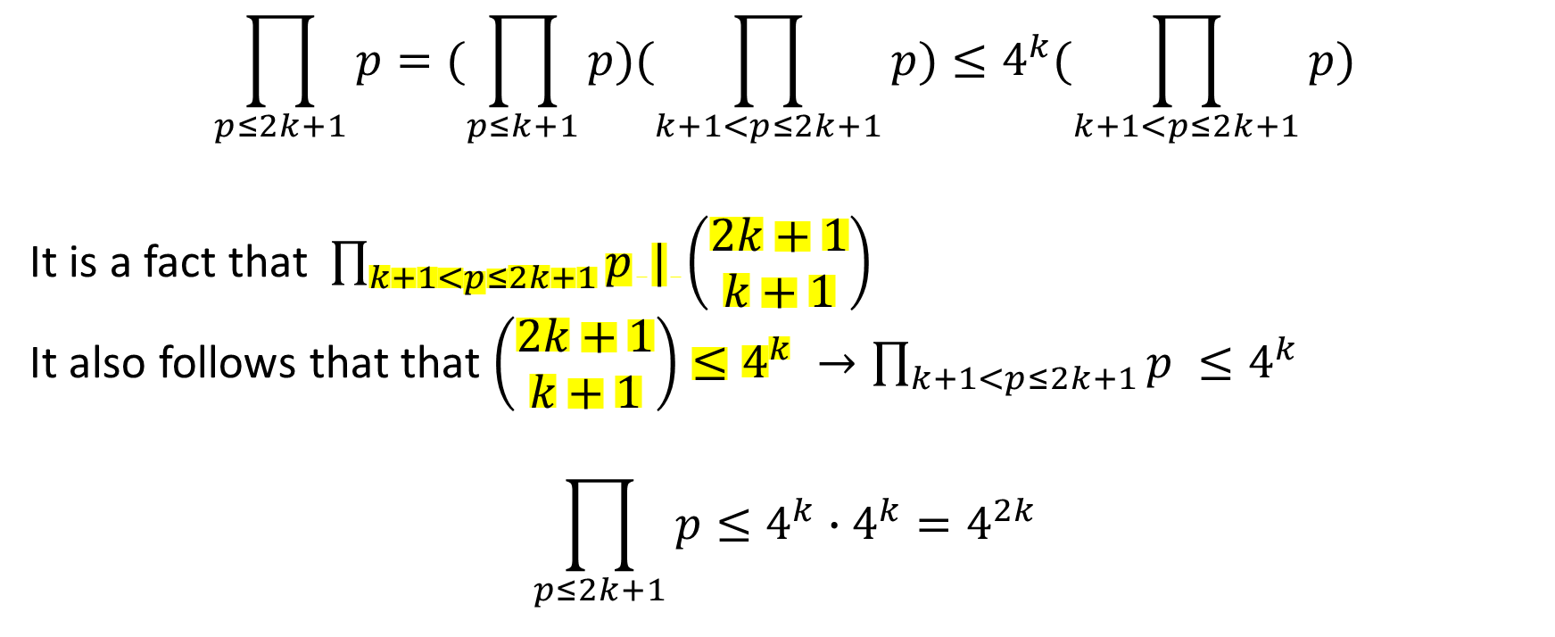

Now consider $n=2k+1$
$$\prod_{p≤2k+1}{p=(\prod_{p≤k+1}{p})(\prod_{k+1<p≤2k+1}{p})≤4^{k}(\prod_{k+1<p≤2k+1}{p})}$$
It is a fact that$\prod_{k+1<p≤2k+1}{p} | \left(\begin{aligned}2k+1 \\ k+1\end{aligned}\right)$
It also follows that that $\left(\begin{aligned}2k+1 \\ k+1\end{aligned}\right)≤4^{k} →\prod_{k+1<p≤2k+1}{p} ≤4^{k}$
$$\prod_{p≤2k+1}{p}≤4^{k}∙4^{k}=4^{2k}$$

Slide 12

The 4 Lemmas part 3; Left as an exercise for a keen reader
If $p$ is a prime and $p | \left(\begin{aligned}2n \\ n\end{aligned}\right)$and $α$ is the power of $p$ in the prime factorisation of $\left(\begin{aligned}2n \\ n\end{aligned}\right)$
Then, $p^{α}≤2n$

Slide 13
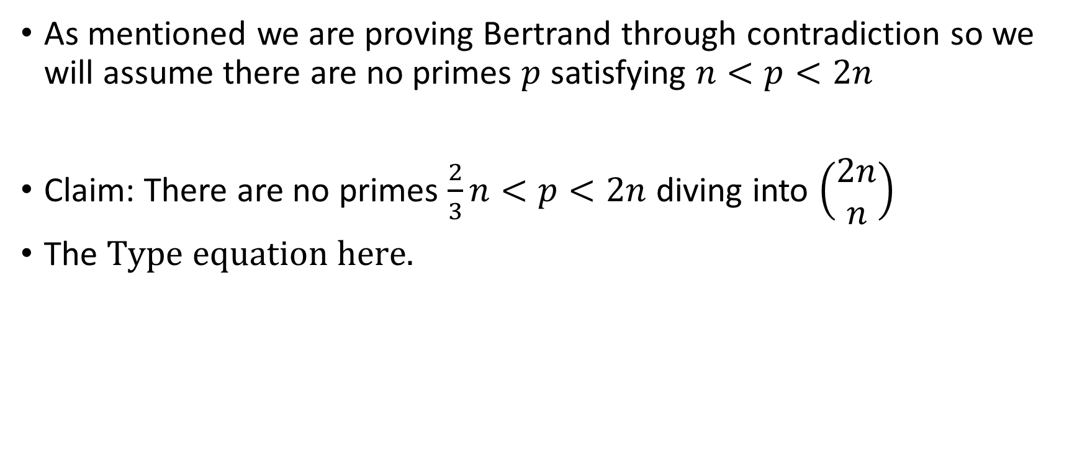
The 4 Lemmas part 4; Some funky inequalities
As mentioned we are proving Bertrand through contradiction so we will assume there are no primes $p$ satisfying $n<p<2n$
Claim: There are no primes $\frac{2}{3}n<p<2n$ diving into $\left(\begin{aligned}2n \\ n\end{aligned}\right)$
The

Slide 14
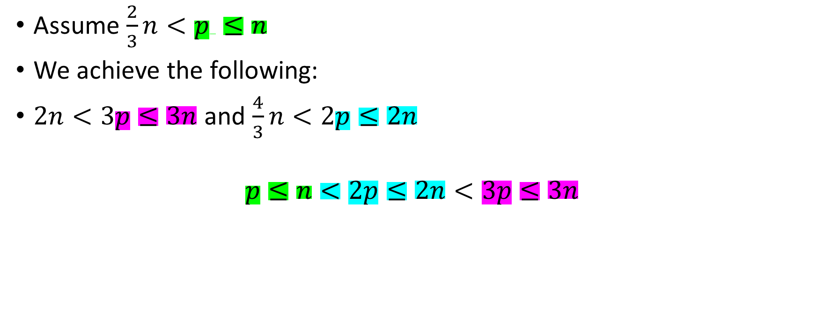
Consider the following
Assume $\frac{2}{3}n<p ≤n$
We achieve the following:
$2n<3p≤3n$ and $\frac{4}{3}n<2p≤2n$
$$p≤n<2p≤2n<3p≤3n$$

Slide 15
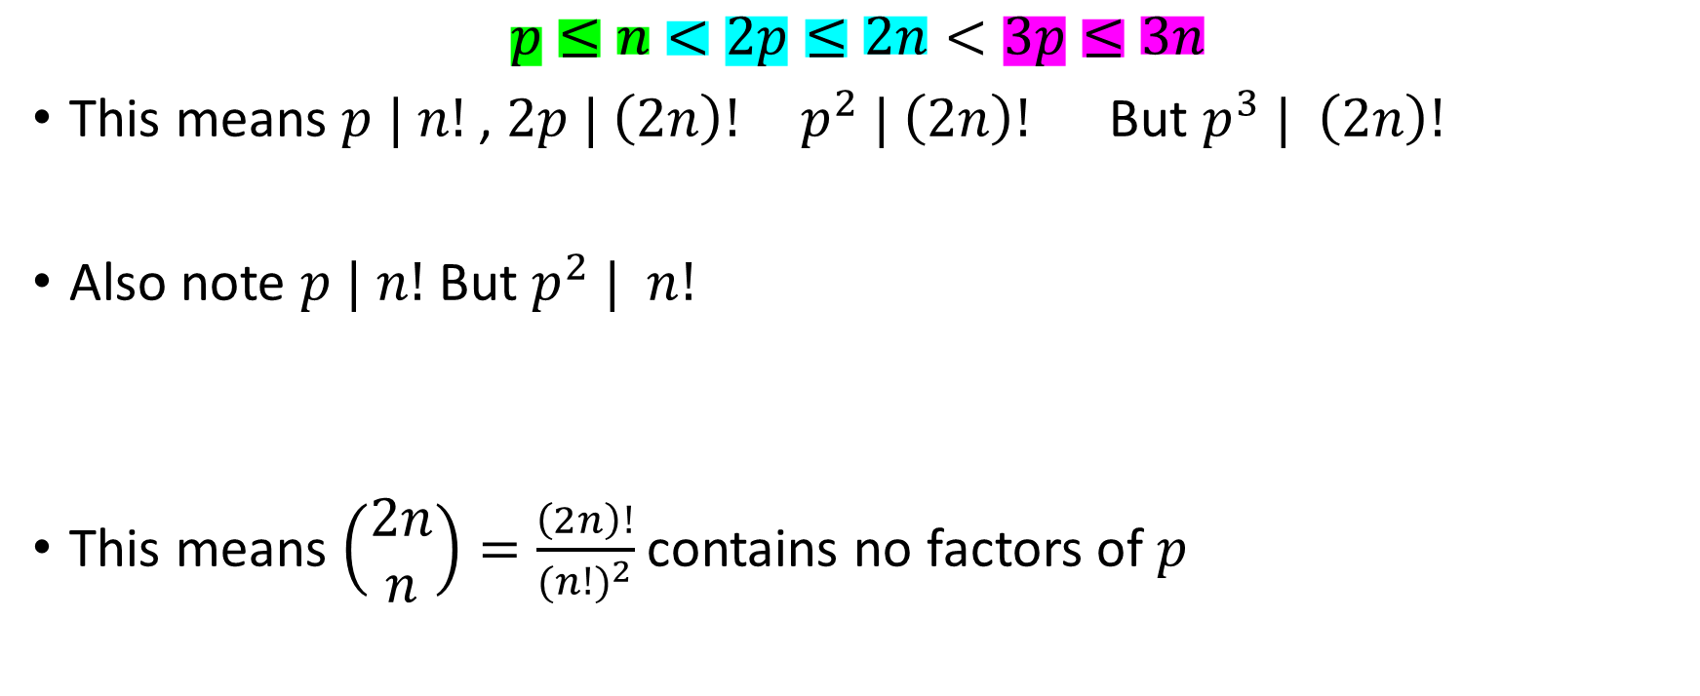
$$p≤n<2p≤2n<3p≤3n$$
This means $p | n!$, $2p | \left(2n\right)! p^{2} | \left(2n\right)!$ But $p^{3} | \left(2n\right)!$
Also note $p | n!$ But $p^{2} | n!$
This means $\left(\begin{aligned}2n \\ n\end{aligned}\right)=\frac{\left(2n\right)!}{{(n!)}^{2}}$contains no factors of $p$

Slide 16
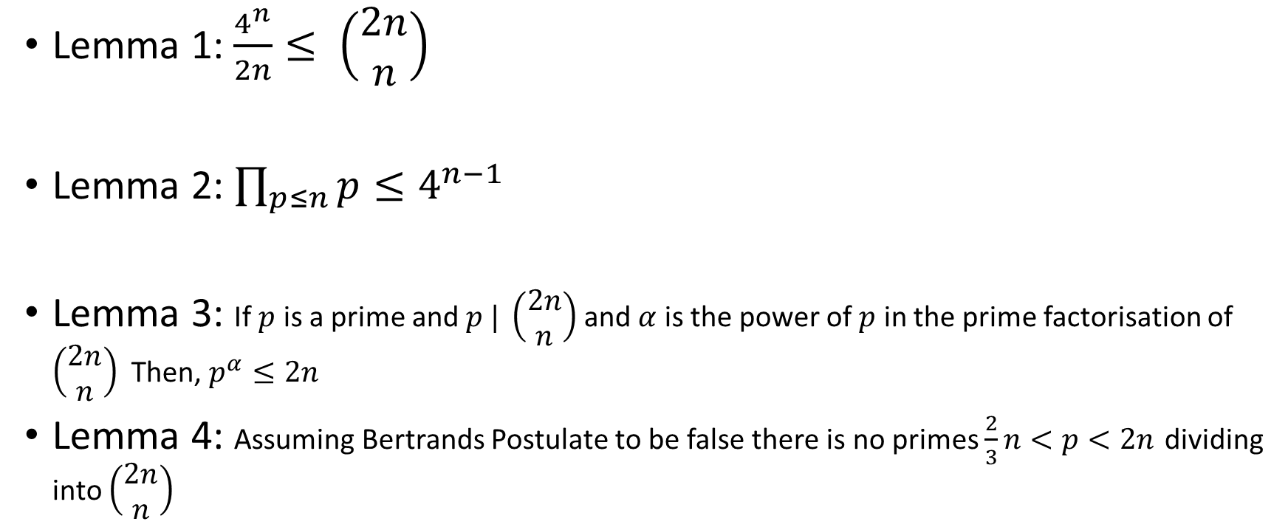
Recall
Lemma 1: $\frac{4^{n}}{2n}≤ \left(\begin{aligned}2n \\ n\end{aligned}\right)$
Lemma 2: $\prod_{p≤n}{p}≤4^{n−1}$
Lemma 3: If $p$ is a prime and $p | \left(\begin{aligned}2n \\ n\end{aligned}\right)$and $α$ is the power of $p$ in the prime factorisation of $\left(\begin{aligned}2n \\ n\end{aligned}\right)$Then, $p^{α}≤2n$
Lemma 4: Assuming Bertrands Postulate to be false there is no primes $\frac{2}{3}n<p<2n$ dividing into $\left(\begin{aligned}2n \\ n\end{aligned}\right)$

Slide 17
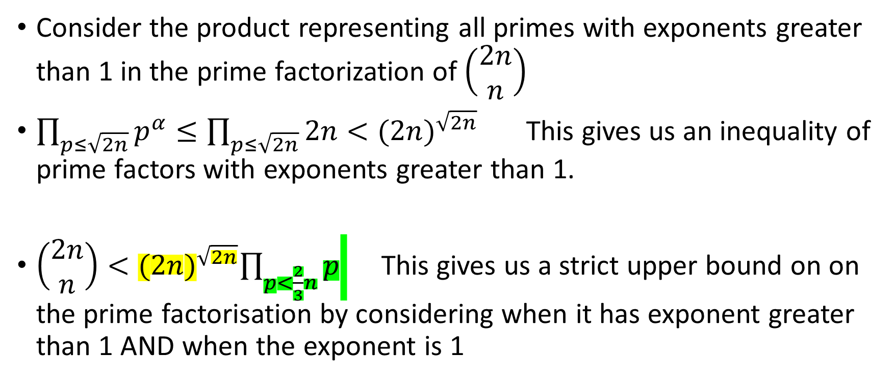

Suppose Bertrand is false for some $n$
Consider the product representing all primes with exponents greater than 1 in the prime factorization of $\left(\begin{aligned}2n \\ n\end{aligned}\right)$
$\prod_{p≤\sqrt{2n}}{p^{α}}≤\prod_{p≤\sqrt{2n}}{2n}<{(2n)}^{\sqrt{2n}}$ This gives us an inequality of prime factors with exponents greater than 1.
$\left(\begin{aligned}2n \\ n\end{aligned}\right)<{(2n)}^{\sqrt{2n}}\prod_{p<\frac{2}{3}n}{p}$ This gives us a strict upper bound on on the prime factorisation by considering when it has exponent greater than 1 AND when the exponent is 1

Slide 18






$$\frac{4^{n}}{2n}<{(2n)}^{\sqrt{2n}}\prod_{p<\frac{2}{3}n}{p}≤{(2n)}^{\sqrt{2n}}∙4^{\left\lfloor \frac{2}{3}n\right\rfloor −1}$$
$$4^{n−\left\lfloor \frac{2}{3}n\right\rfloor +1}<{(2n)}^{1+\sqrt{2n}}$$
$$\frac{1}{3}\left(n+3\right)ln3<\left(1+\sqrt{2n}\right)ln2n$$
Lemma 1
Few lines of mathematical trickery missed out

Slide 19
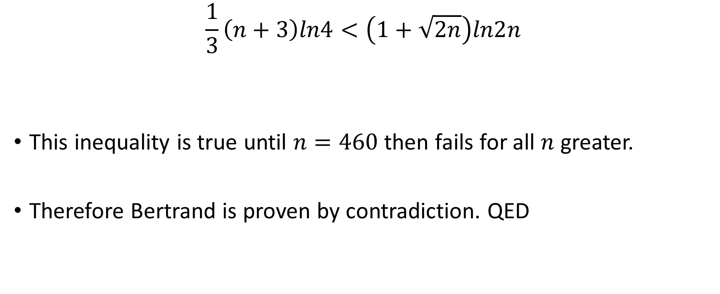
$$\frac{1}{3}\left(n+3\right)ln4<\left(1+\sqrt{2n}\right)ln2n$$
This inequality is true until $n=460$ then fails for all $n$ greater.
Therefore Bertrand is proven by contradiction. QED

